Slide 1
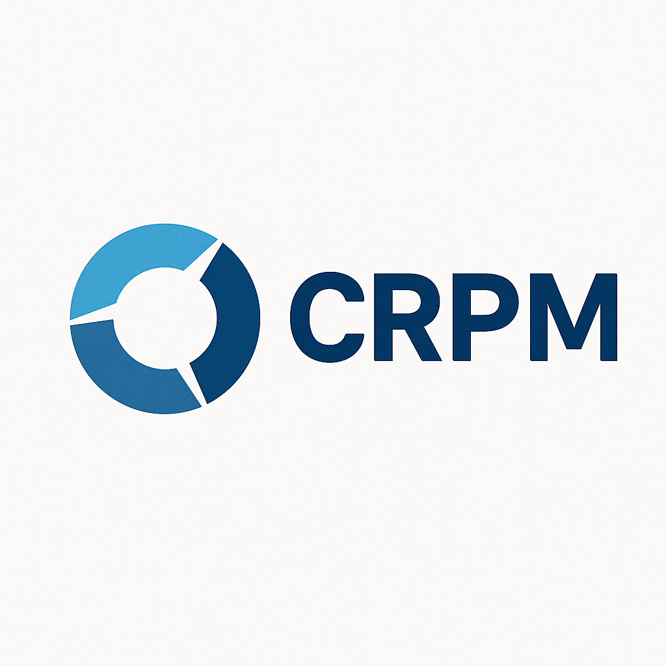
CPRM - Centralized Patient & Resource Management System
Smart Display System for Wenlock Hospital
- Submission By Gauresh G Pai
Welcome to the presentation on the CPRM system. We will explore its key interfaces, focusing on secure access, dynamic display management, and comprehensive technician controls. This overview highlights the system's efficiency and user-centric design.

Slide 2
The Challenge: 73 Disconnected Displays
Fragmented Display Management
No Real-Time Synchronization
Emergency Alert Gaps
Departments lack live data sharing, delaying actions.
Delayed responses due to alert system failures.
73 screens operate independently, causing inefficiency.
Department Silos
Patient Privacy Concerns
Limited workflows hinder inter-department coordination.
Full names displayed, risking data protection compliance.

Slide 3
CPRM: Unifying Hospital Information Flow
Smart Display Management
Real-Time Data Sync
Privacy-First Token System
Intelligent Emergency Broadcast
Centralized control of all hospital screens.
Ensures accurate, live information sharing.
Protects patient identity while enhancing access.
Rapid alerts to all locations.
Department Integration
Seamless collaboration across units.

Slide 4
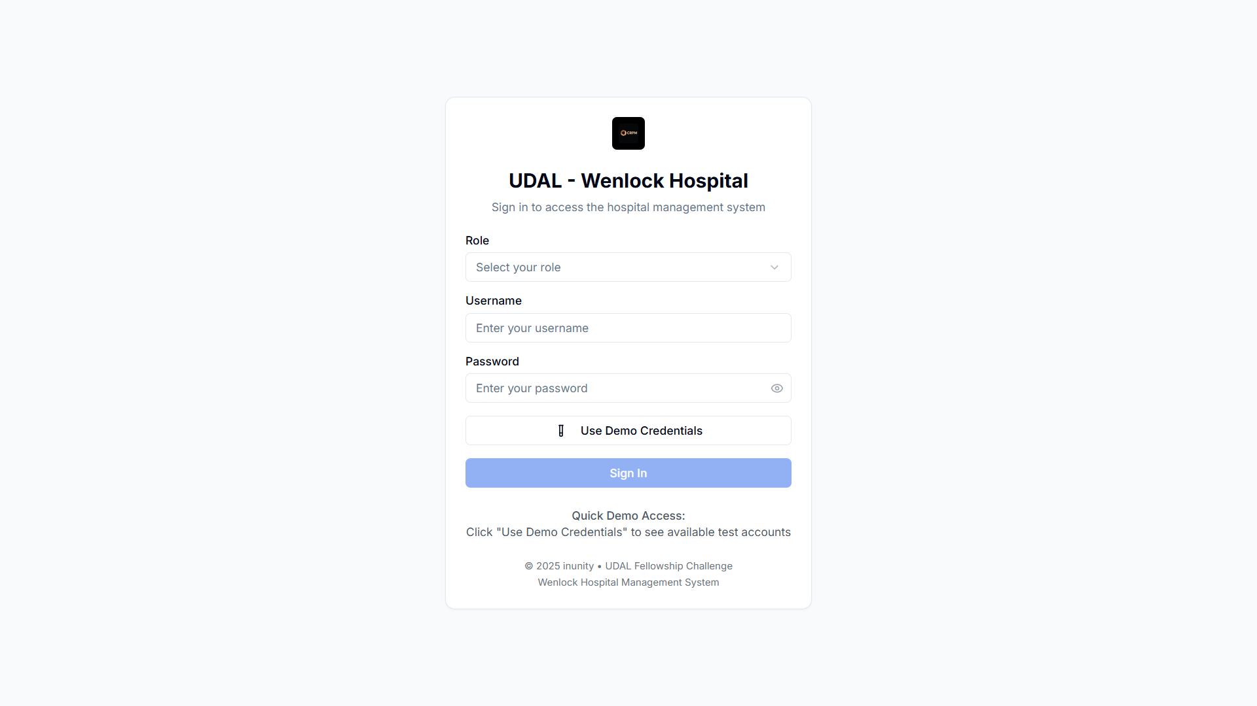
Secure Access: CPRM Login Interface
https://cprm-prototype.vercel.app/login
Role-based authentication system for secure
access
Demo credential access for testing env
Advanced security features and protocols
Intuitive user experience considerations

Slide 5


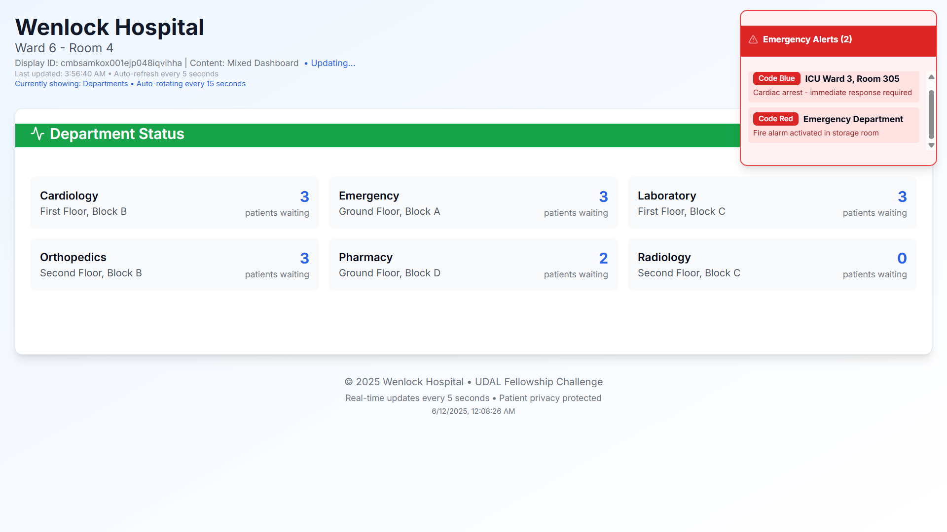


Smart Display System: Personalized Information Delivery
Department-specific queues
Manage patient flow per department.
https://cprm-prototype.vercel.app/display/[id]
Real-time wait estimates
Provide accurate patient waiting times.
Automatic priority sorting
Organize queues by urgency.
Color-coded status
Visual indicators for quick assessment.
The smart display system intelligently manages patient queues. It offers department-specific token systems, real-time wait estimates, and automatic priority sorting. Color-coded status indicators enhance clarity for both patients and staff.

Slide 6
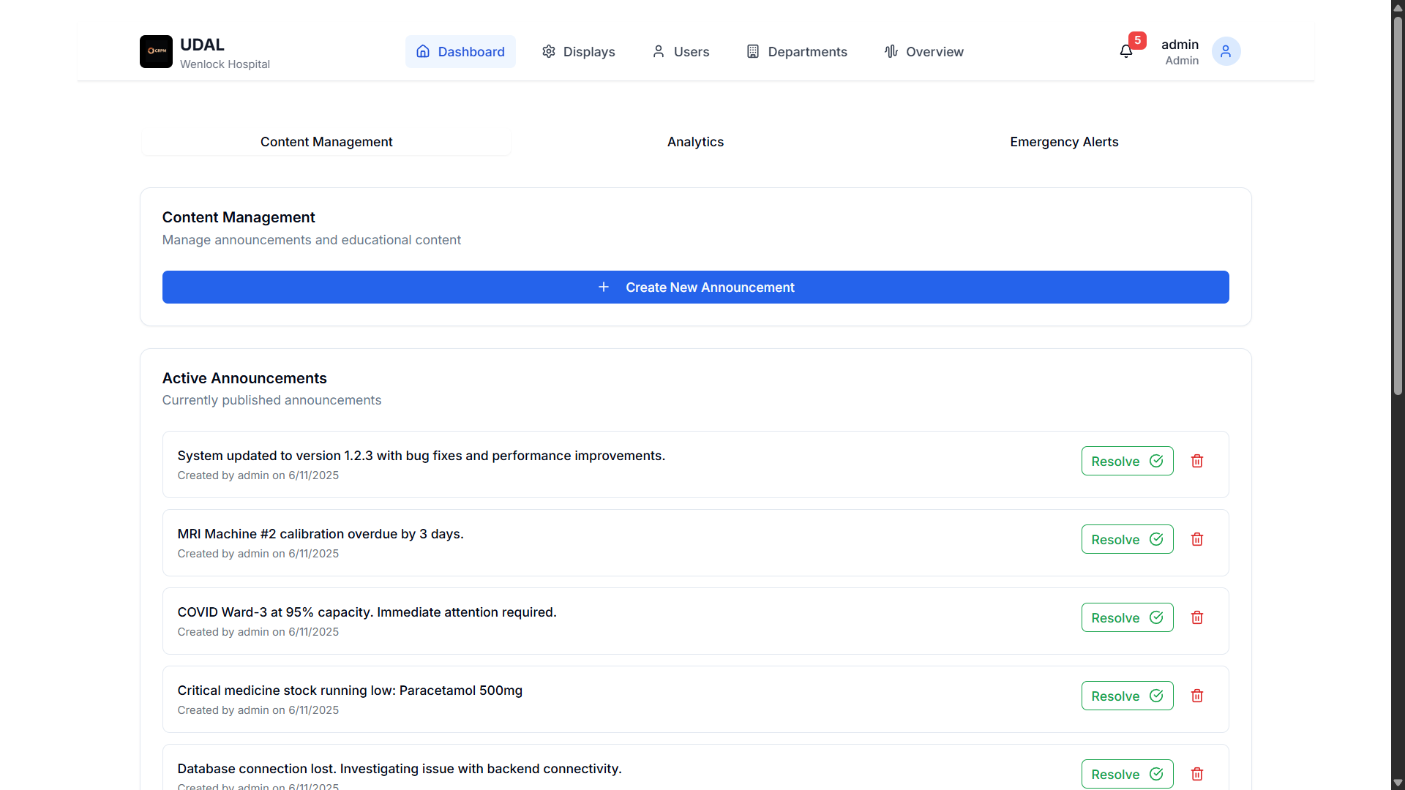
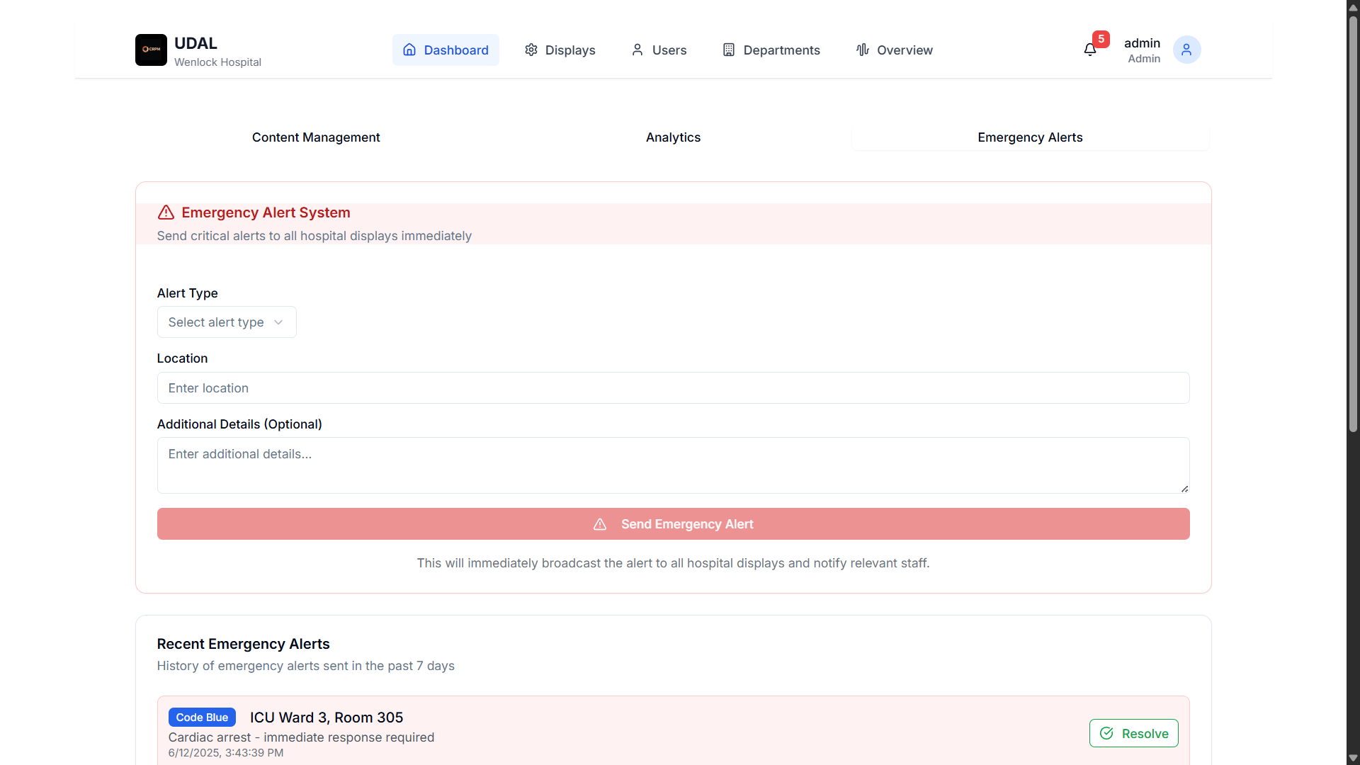
Admin Dashboard: Complete System Control
http://cprm-prototype.vercel.app/admin
System-wide Analytics & Alerts
Department & Display Configuration
Role-Based Access Control
User Management
Monitor display status and emergency notifications.
Customize settings based on hospital needs.
Enhances security by defining user permissions.
Create, assign roles and access easily.

Slide 7

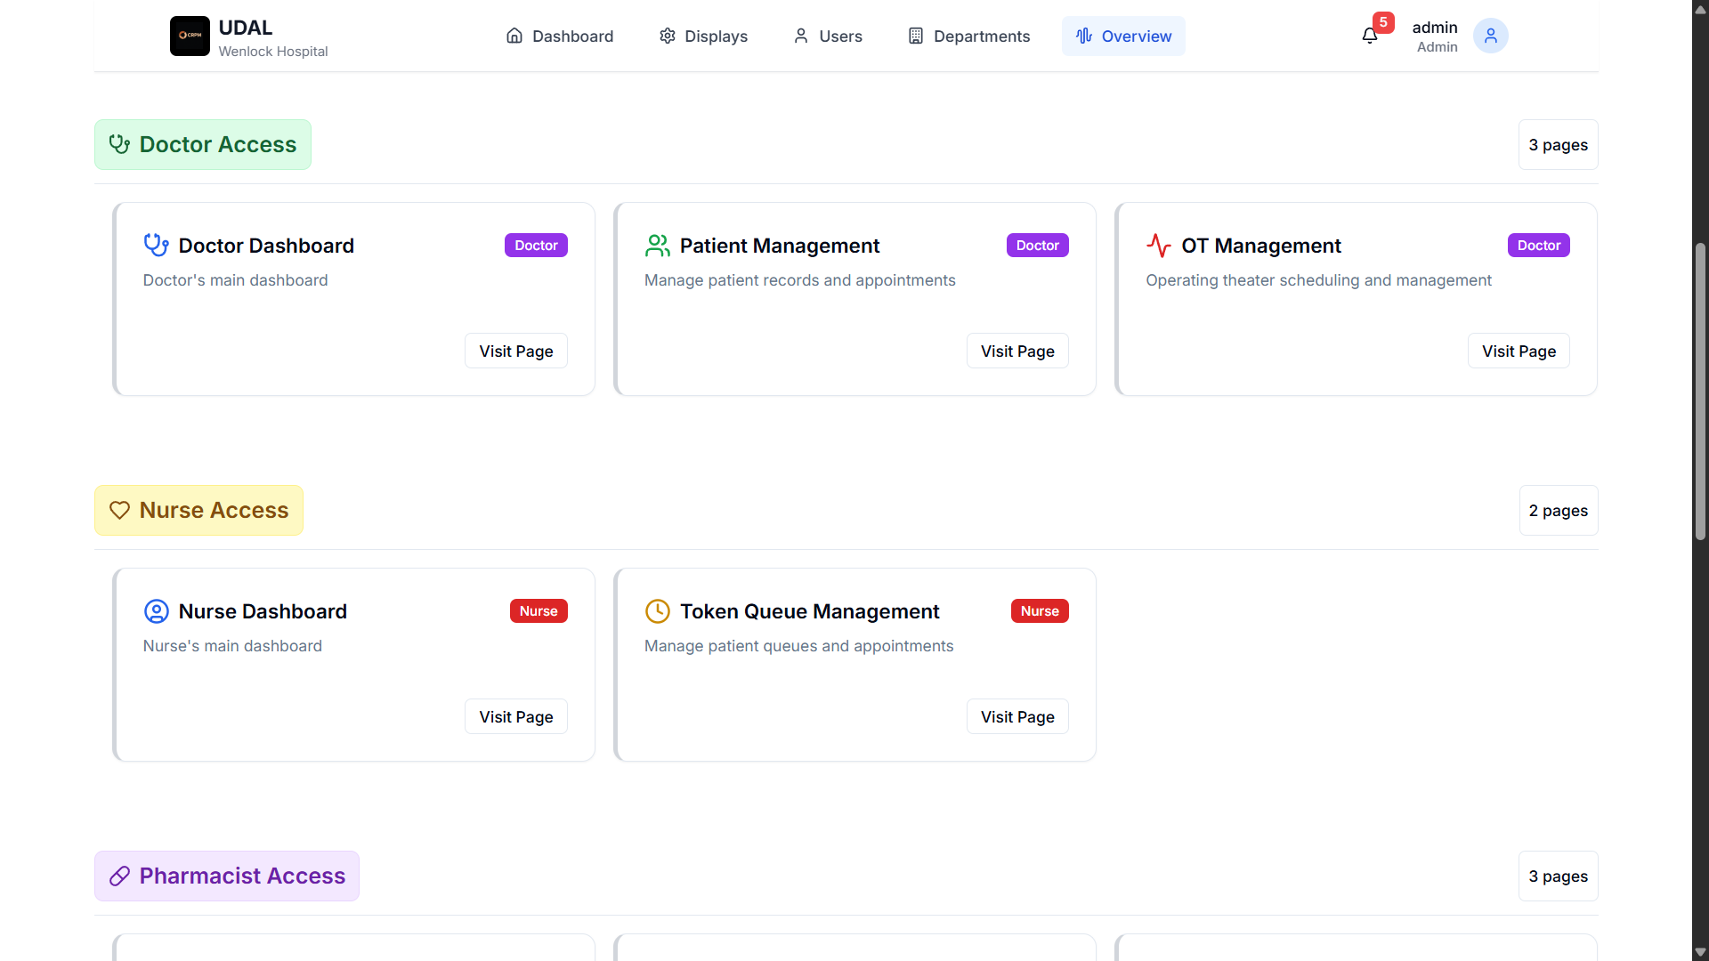


Admin Overview: Centralized Control
https://cprm-prototype.vercel.app/admin/overview
Universal Access Points
Links to all roles and every page are available here.
Role-Based Security
Ensuring appropriate access for each user type.
System Health Metrics
Monitoring overall system performance and status.

Slide 8
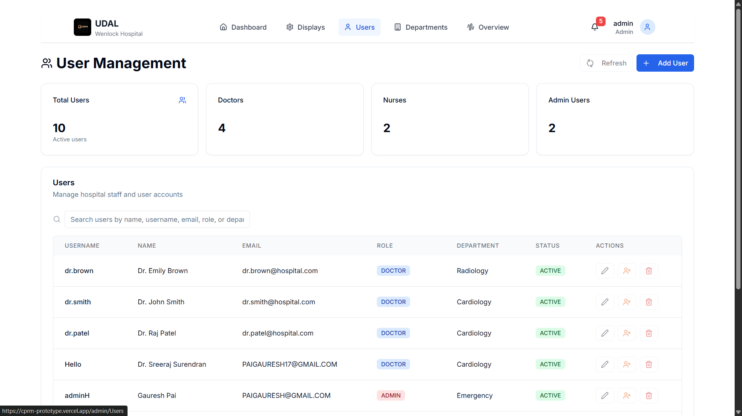
User Management: Role-Based Access Control
https://cprm-prototype.vercel.app/admin/Users
Staff Account Creation
Role Assignment
Department Assignment
Admins, doctors, nurses setup
Admin, Doctor, Nurse roles
Associate staff to correct units

Slide 9

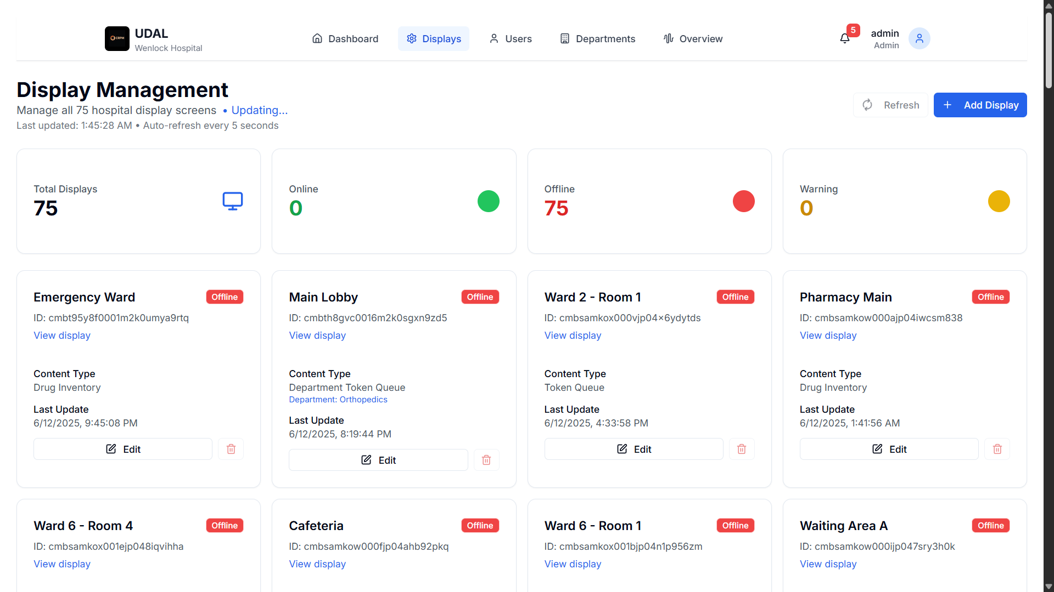



Display Management: 73 Screens, 1 Control Center
https://cprm-prototype.vercel.app/admin/displays
Centralized Control
Manage all hospital displays from one interface.
Content Scheduling & Distribution
Plan messages and update screens in real-time.
Emergency Alert Broadcasting
Instantly send critical alerts to all devices.
Display Health Monitoring
Track status and performance continuously.

Slide 10
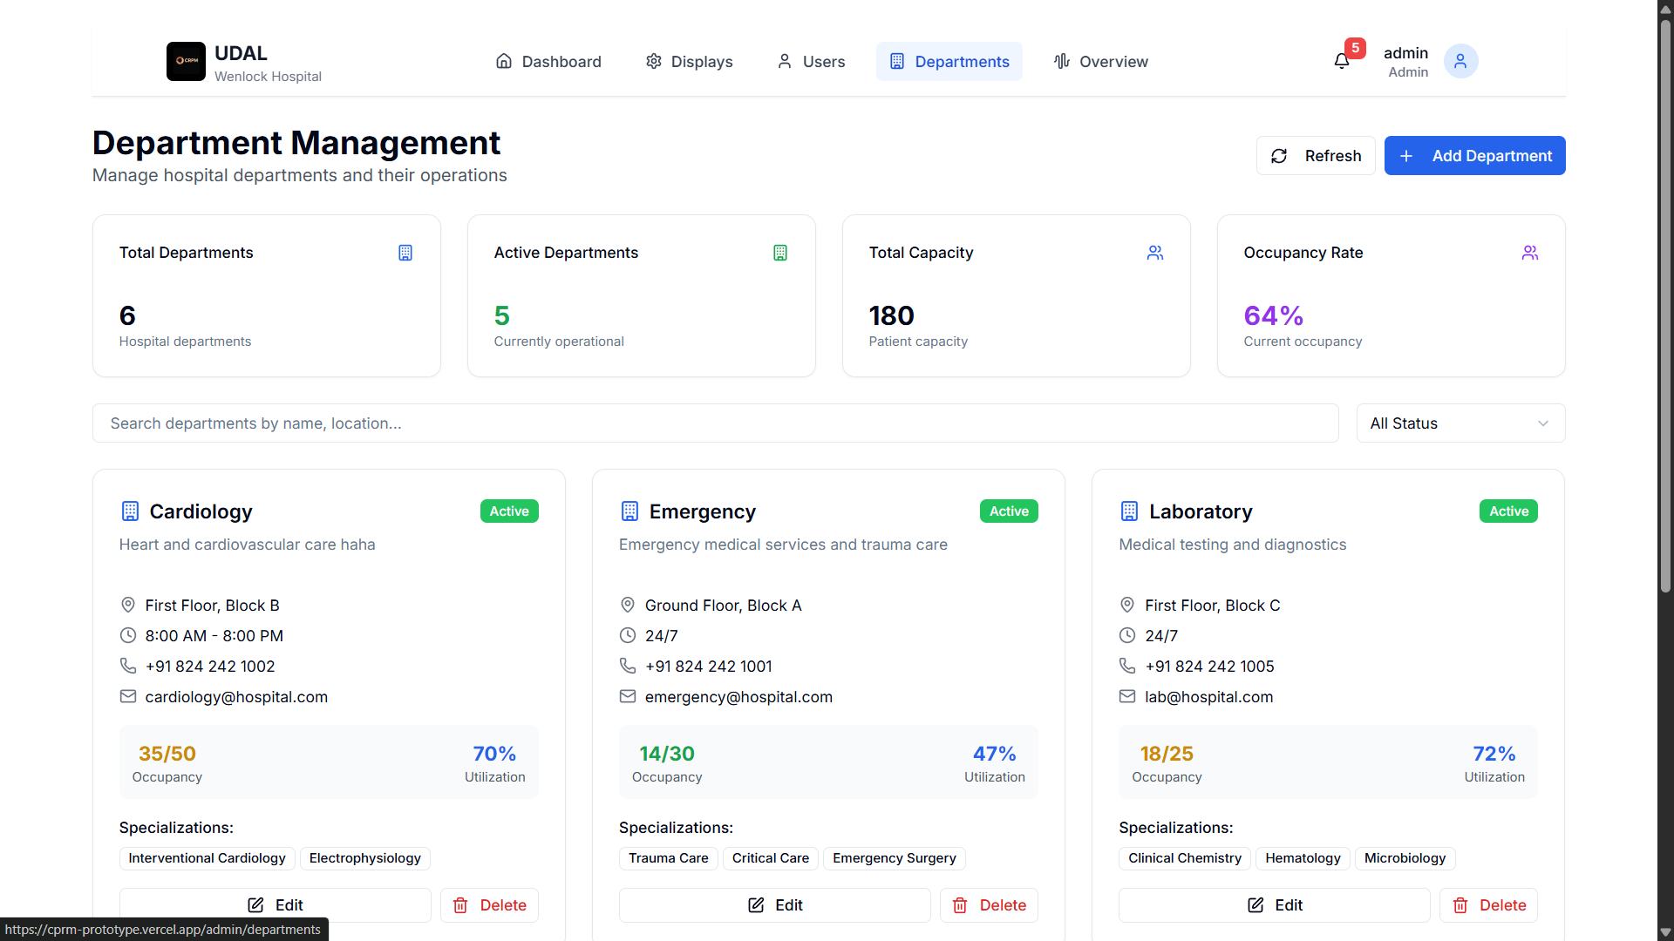



Department Management: Organizational Structure
https://cprm-prototype.vercel.app/admin/departments
Department Creation
Staff Assignment
Setup new hospital units efficiently.
Allocate personnel to departments precisely.
Resource Allocation
Optimize equipment and supplies distribution.

Slide 11
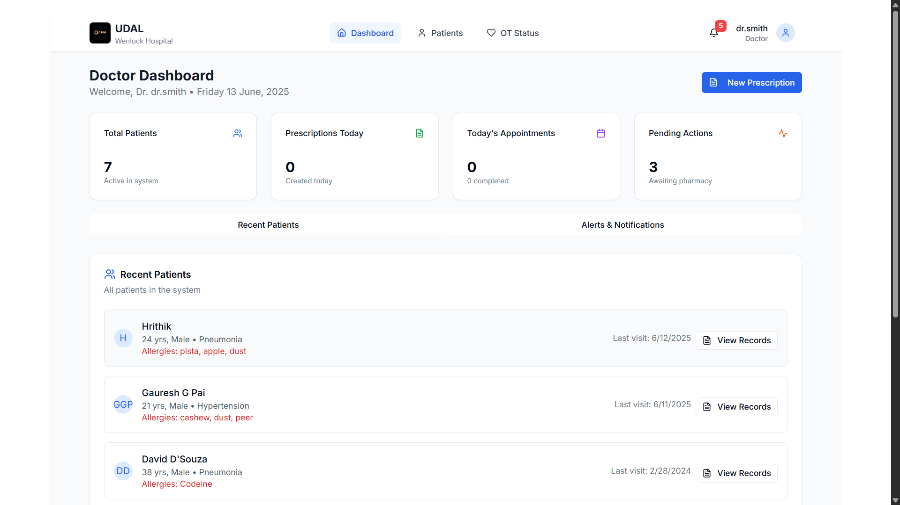
Doctor Dashboard: Patient-Centered Care
https://cprm-prototype.vercel.app/doctor
Patient & Appointment Management
Operating Theater Scheduling
Optimize surgical workflows and resource use.
Medical Record Access
Quick retrieval of patient history and data.
Emergency Coordination
Efficient response enabled through integrated alerts.

Slide 12
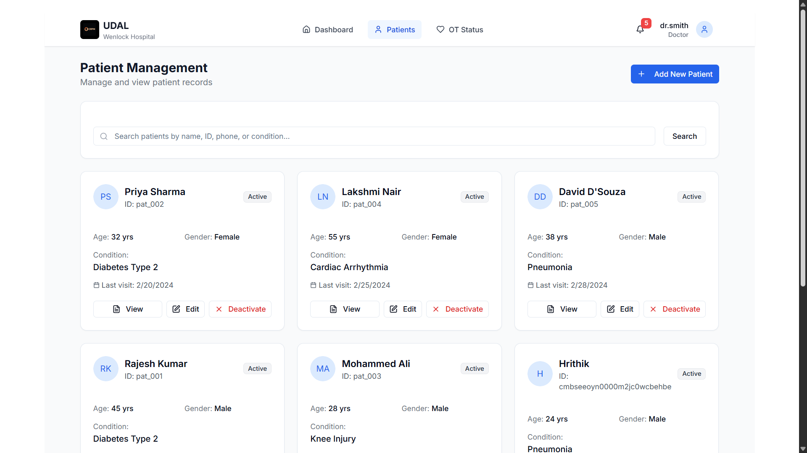
Patient Management: Streamlined Care Coordination
Comprehensive Records
https://cprm-prototype.vercel.app/doctor/patients
All patient data in one place
Appointment Scheduling
Easy booking and tracking
Medical History
Accessible treatment plans
Department Integration
Seamless cross-department flow

Slide 13
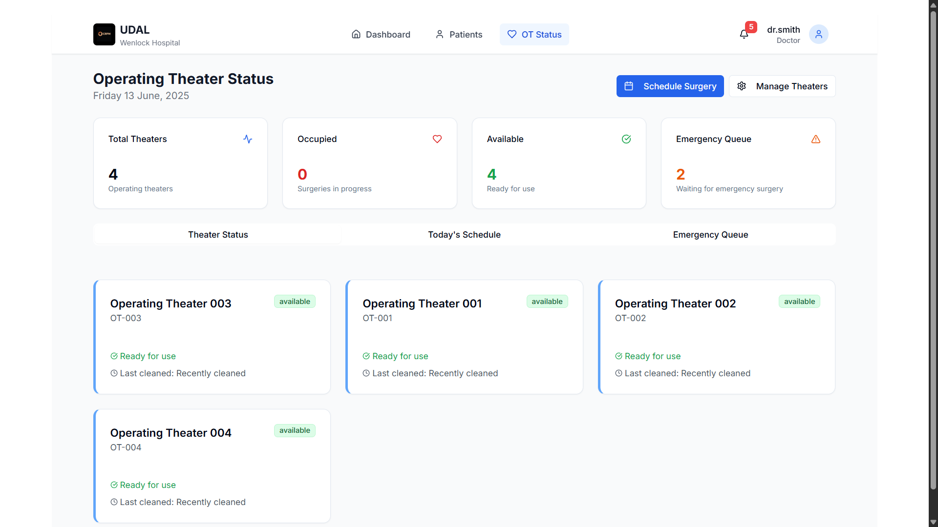
OT Management: Streamlined Surgical Workflow
Efficient Scheduling
Surgery scheduling and resource allocation are optimized.
https://cprm-prototype.vercel.app/doctor/ot
Real-Time Updates
Live status updates for all surgical procedures.
Pharmacy Integration
Seamless medication preparation with pharmacy.
Emergency Prioritization
Critical surgeries are automatically prioritized.

Slide 14
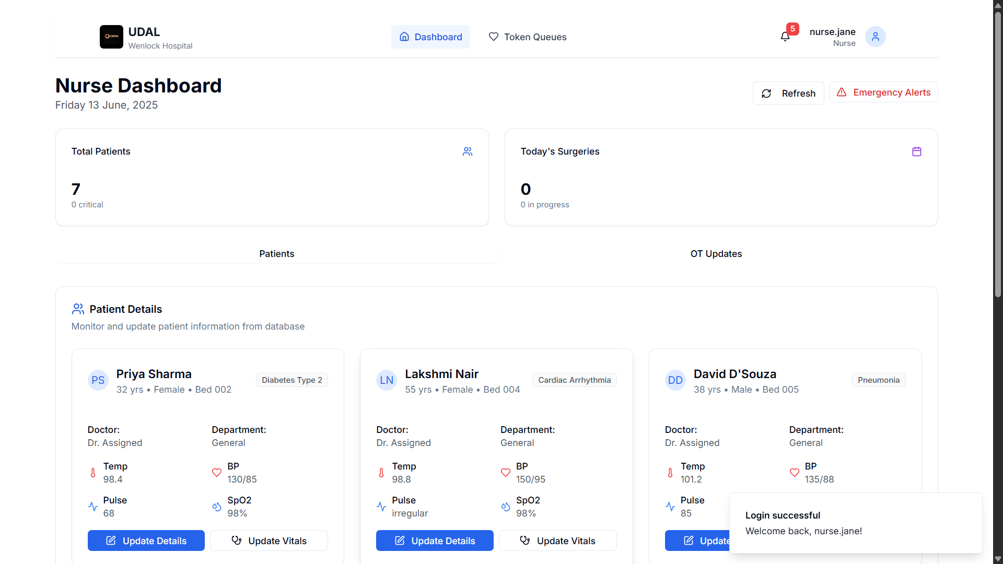
Nurse Dashboard:
Patient Flow Management
https://cprm-prototype.vercel.app/nurse
Patient Queue
Vital Signs
Manages patient flow efficiently and effectively.
Monitors crucial patient vital signs in real-time.
Task Assignment
Communication Hub
Assigns and tracks all nursing tasks directly.
Facilitates communication with doctors and pharmacy.

Slide 15

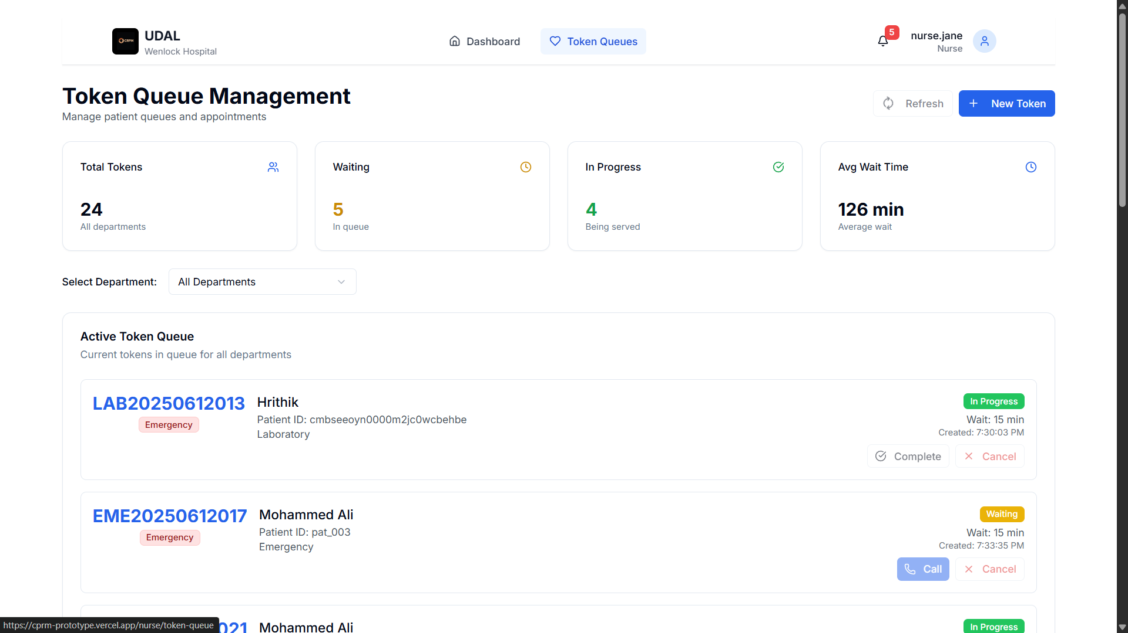



Token Queue: Privacy-First Patient Management
https://cprm-prototype.vercel.app/nurse/token-queue
Token-Based ID
Patients identified by tokens (P001, P002).
Wait Time Estimates
Accurate wait time management and display.
Department Routing
Coordinated patient routing to departments.
Privacy Protection
Ensures complete patient privacy and anonymity.

Slide 16
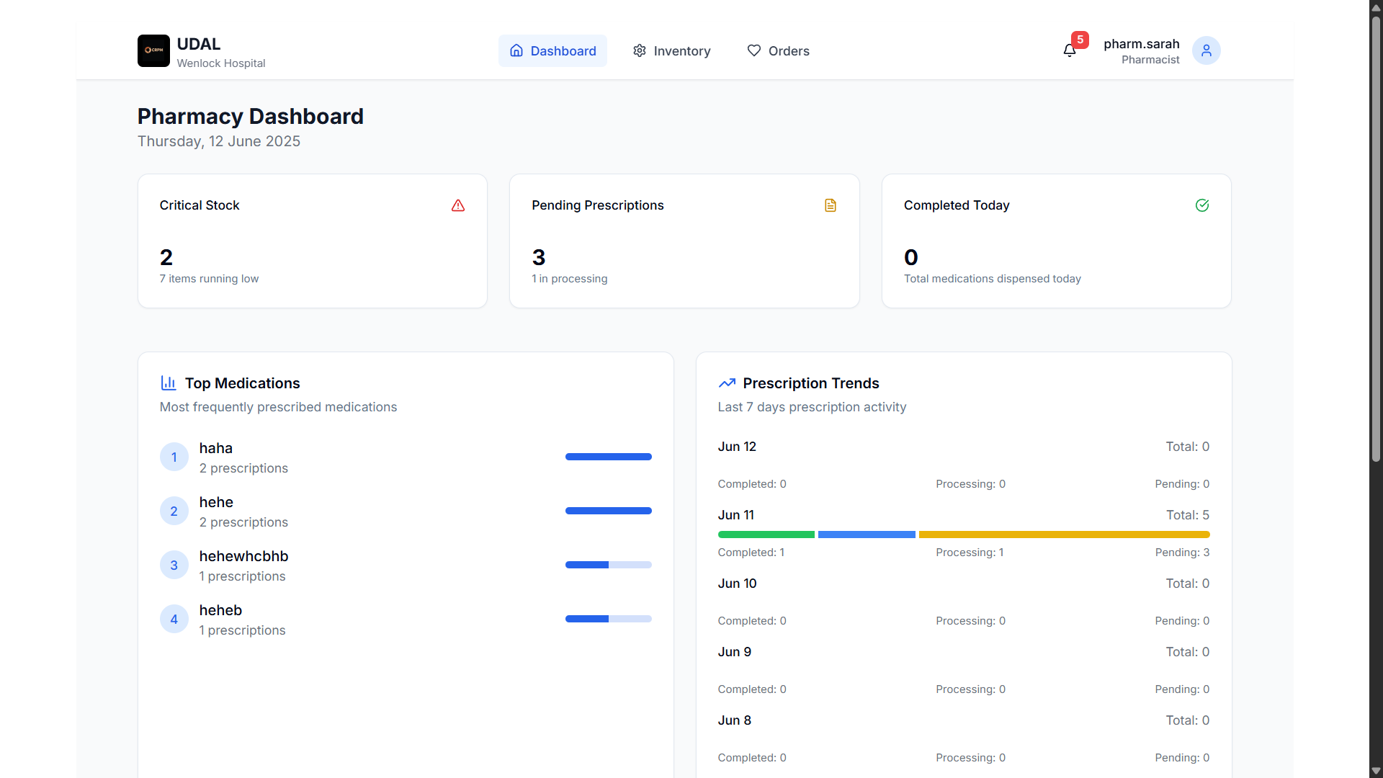
Pharmacy Management: Medication Workflow
Inventory Control
https://cprm-prototype.vercel.app/pharmacist
Manages inventory and generates stock alerts.
Prescription Processing
Streamlines all prescription dispensing.
OT Integration
Coordinates with OT for surgery preparations.
Dispensing Tracking
Monitors all medication distribution.

Slide 17
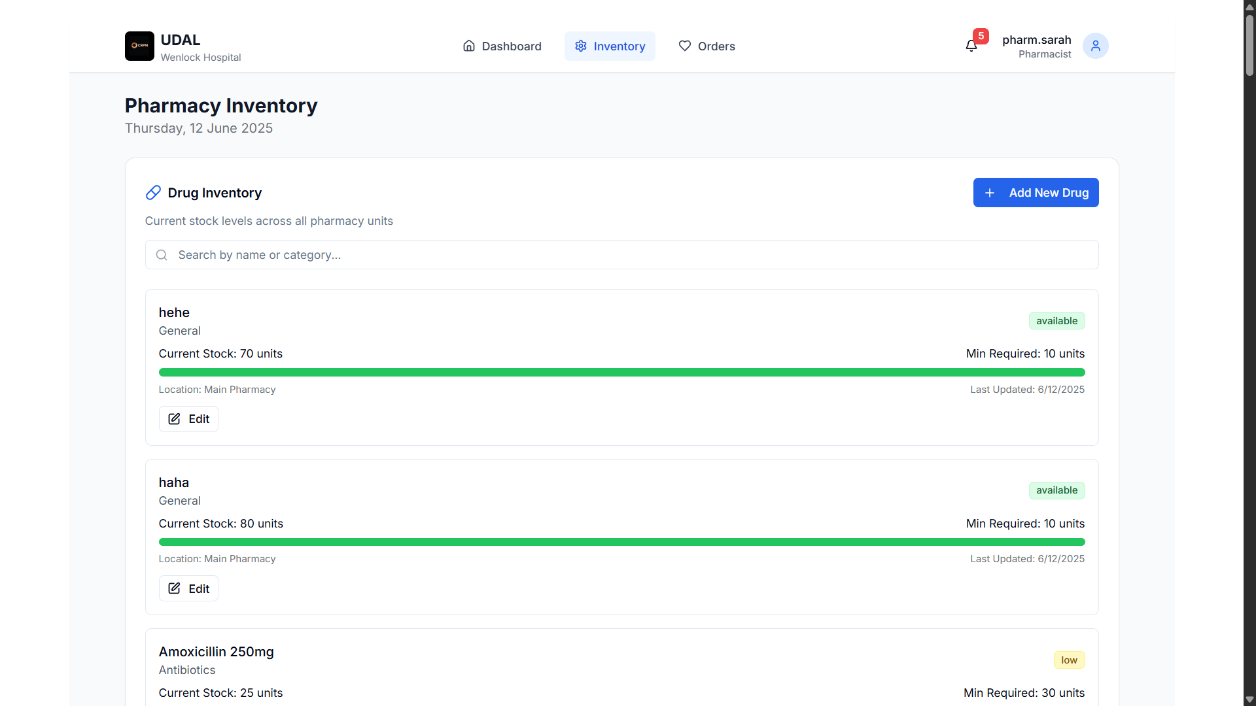
Drug Inventory: Real-Time Stock Management
https://cprm-prototype.vercel.app/pharmacist/inventory
24/7
95%
Real-time Tracking
Low Stock Alerts
Critical and low status
Always know stock levels

Slide 18

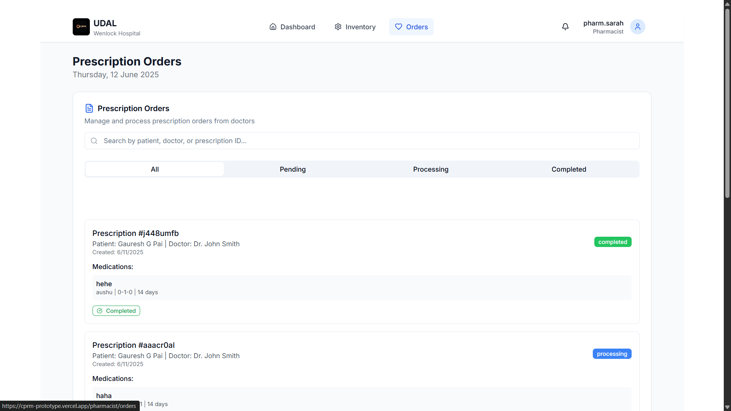



Prescription Orders: Efficient Medication Workflow
Digital Processing
Paperless prescriptions
https://cprm-prototype.vercel.app/pharmacist/orders
Medication Tracking
From order to dispense
Doctor-Pharmacy Link
Clear communication
Patient Notifications
Pickup alerts

Slide 19
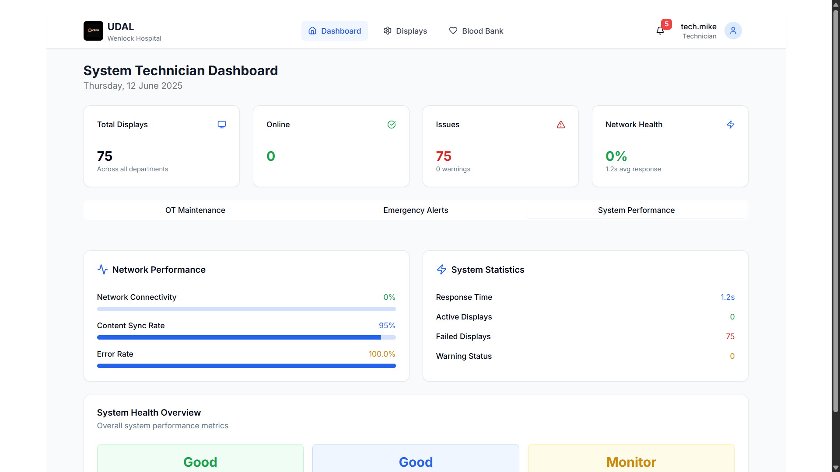
System Control: Technician Interface
https://cprm-prototype.vercel.app/technician/
System Health Monitoring
Operating Theater Tracking
Comprehensive overview of system status
Monitor maintenance schedules effectively
Emergency Alert Management
Respond to critical alerts promptly

Slide 20


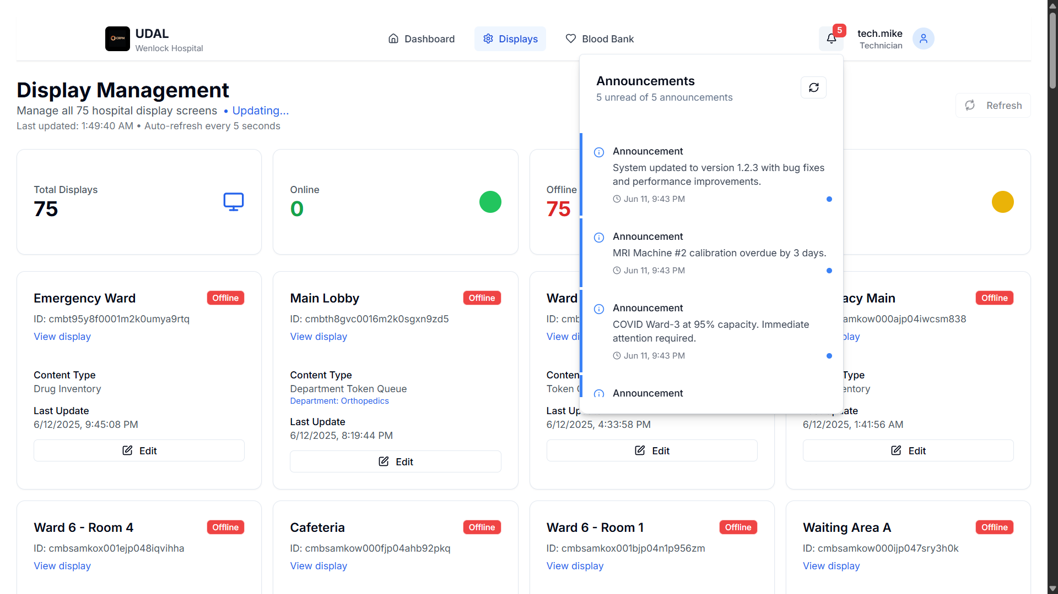


Display Maintenance: Centralized Screen Management
Monitor Displays
https://cprm-prototype.vercel.app/technician/displays
Schedule Content
Control all 73 screens
Targeted information
Track Health
Remote Troubleshooting
Proactive issue detection
Quick fixes

Slide 21
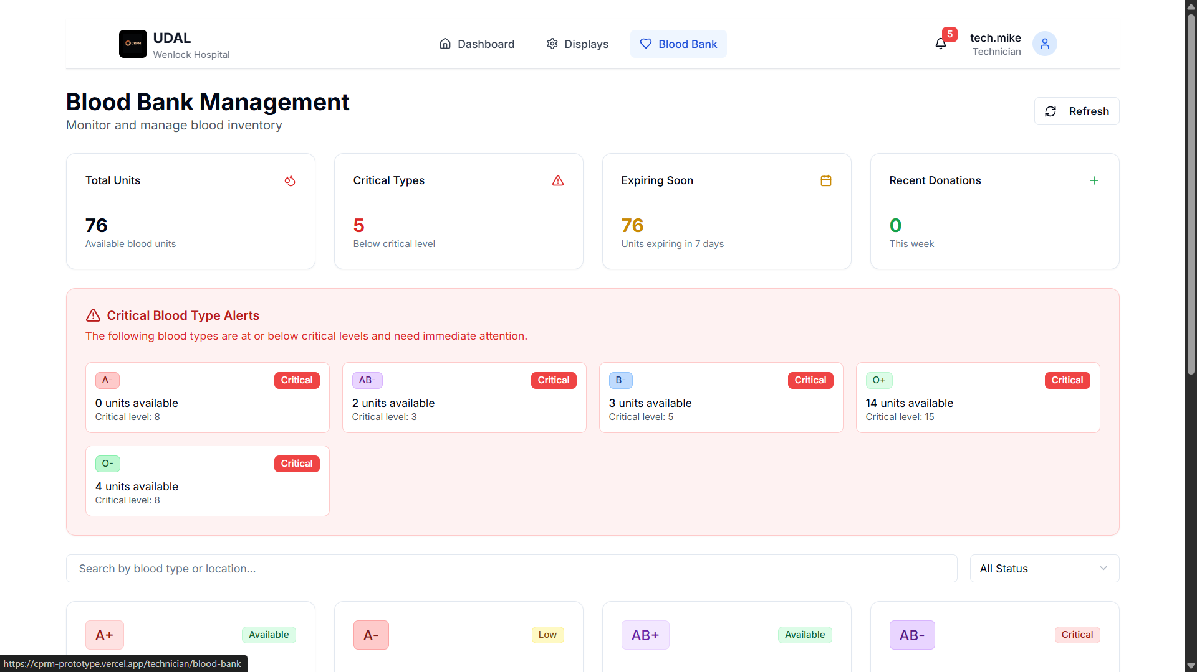
Blood Bank: Life-Saving Resource Management
Inventory Tracking
https://cprm-prototype.vercel.app/technician/blood-bank
Real-time blood inventory by type.
Donation Management
Efficiently manages all blood donations.
Emergency Allocation
Rapid allocation during critical emergencies.
Expiration Monitoring
Tracks blood product expiration dates.

Slide 22
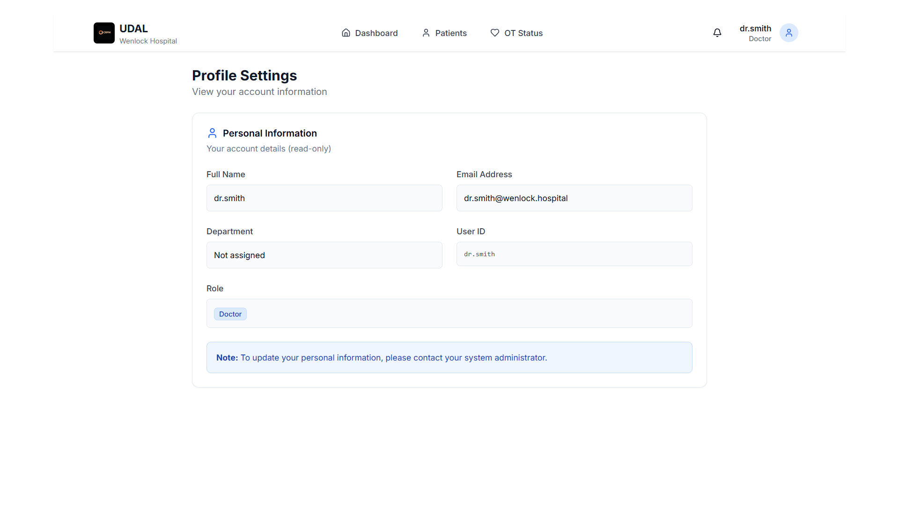
https://cprm-prototype.vercel.app/profile-settings
Profile Settings: Personalized User Experience

Slide 23
Thank You
Contact Information
Project Repository
Email: paigauresh@gmail.com
https://github.com/gaureshpai/cprm-prototype
Website: gauresh.vercel.app
https://cprm-prototype.vercel.app/

